Slide 1









WORKSHOPS
Build Robust Schema-Driven AI Apps with Marvin AI
Paul Quigley
Founder
Zero Shot Labs, LLC

Slide 2

Table of Contents / Agenda
1
Introduction
Objective | About Marvin | Prerequisites
2
Understanding Features of Marvin in Detail
11 Features
3
Walk Through Example on Colab
Advanced Examples and Demos
4
Quiz
6 Questions
5
Final Exercise
4 Tasks
6
Q & A

Slide 3


INTRODUCTION

Slide 4

Objective
By the end of this workshop you will be able to
Build LLM based applications using Marvin AI Toolkit with following features:
Text:
Classify text into categories
Extract structured entities from text
Transform text into structured data
Generate synthetic data from a schema
Images
Create images from text or functions
Describe images with natural language
Classify images into categories
Extract structured entities from images
Transform images into structured data
Speech
Generate speech from text or functions

Slide 5
About Marvin
The AI Engineering Toolkit
A lightweight AI toolkit for building reliable, scalable, and easy to trust NLP interfaces.
Modular design. Each submodule is simple and self-documenting, independent and incrementally adoptable, so you can use them in combination with any other library.
Multimodal (text + image + audio).
When using AI is more important than building AI.
Incorporates best practices for building dependable, observable software using generative AI into a single, easy-to-use library.
Marvin is open-source and free to use

Slide 6
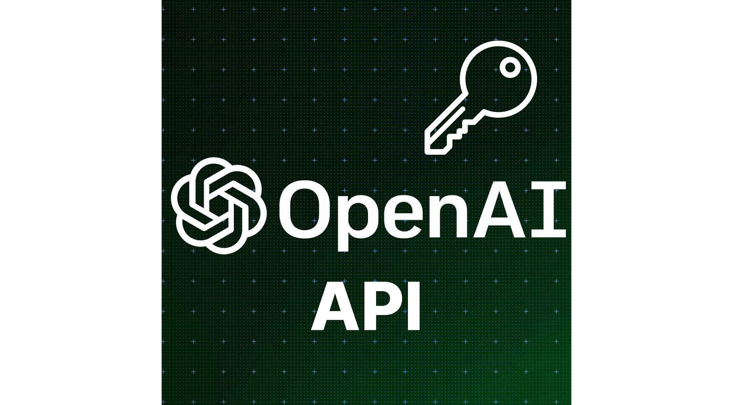



Prerequisites
Following is required
OpenAI API Key (with paid subscription)
Basic familiarity with Python and Google Colab
Basic familiarity with prompting/ Large Language Models (LLMs)
Basic familiarity with multi-modal models

Slide 7
Understanding Functions of Marvin

Slide 8
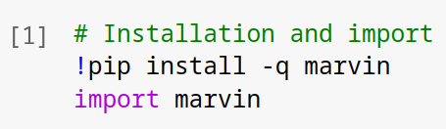
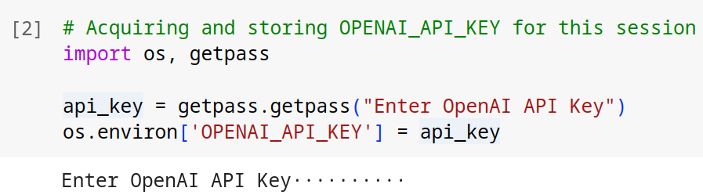
Installation and Setup
Installation
Can be installed using PyPI (pip)
Entering the OpenAI API Key
The OpenAI key is to be supplied as an environment variable ‘OPENAI_API_KEY’

Slide 9
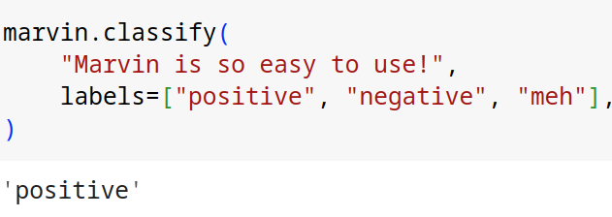
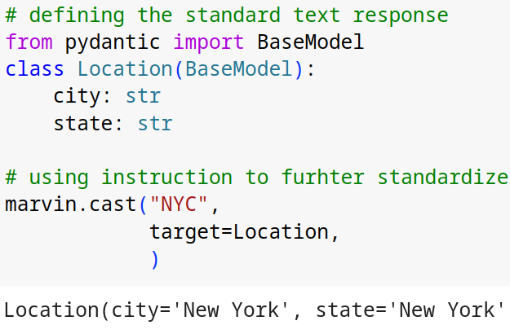
Using Marvin for Text
Text Classification
Given some text and a list of labels, Marvin will choose the label that best fits the text.
The 'classify' function is great for tasks like sentiment analysis, intent classification, routing, and more.
Text Standardization / Structuring
Marvin lets you convert text to a more structured form.
Given some text and a target type, 'cast' function will return a structured representation of the text.

Slide 10
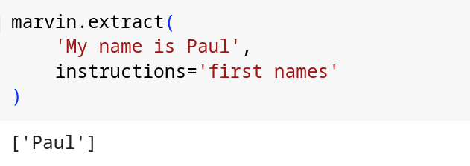
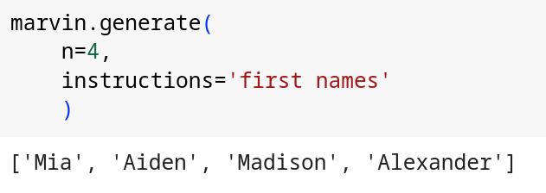
Using Marvin for Text
Data Extraction from Text
Marvin can be used to extract useful information from text through its “extract” function.
“Instructions” keyword is used to define what data to extract.
Generate Text Data
Marvin can generate synthetic data from a schema and instructions using its 'generate' function
“n” keyword is used to define number of data poitns
“Instructions” keyword is used to describe data

Slide 11
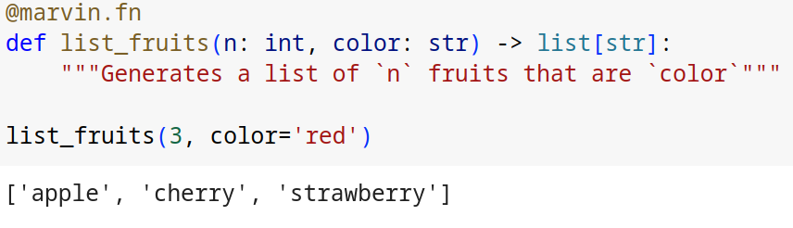
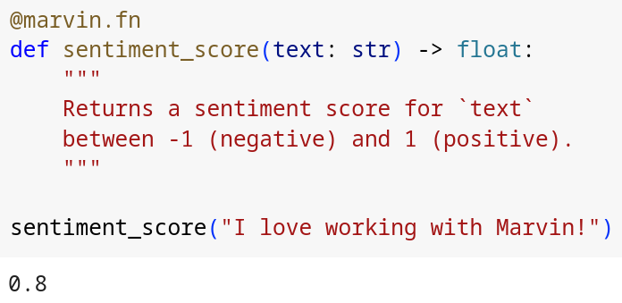
Using Marvin for Text
Custom AI Functions
Marvin 'AI functions' feature lets you combine any inputs, instructions, and output types to create custom AI-powered functionality.
We use @marvin.fn decorator for this purpose.
Marvin passes the function you define as a prompt to the LLM under the hood.
We can implement classification, generation, standardization or any other function using this feature.

Slide 12
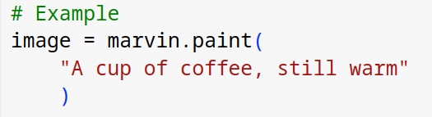

Using Marvin for Images
Text to Image (Image Generation)
The 'paint' function generates images from text.
The @image decorator generates images from the output of a function.
Under the hood, Marvin passes your prompt to the DALL-E 3 API, which returns an image.

Slide 13
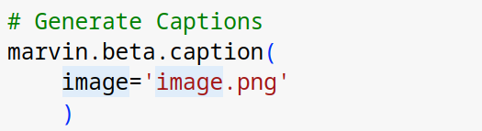
Using Marvin for Images
Image to Text (Captioning)
Marvin can use OpenAI's vision API to process images as inputs
Marvin passes your images to the OpenAI vision API as part of a larger prompt.
The 'beta.caption' function generates text from images.
Please note that vision support in Marvin is still in beta, as OpenAI has not finalized the vision API yet. While it works as expected, it is subject to change.
Caption:
A steaming cup of coffee with a frothy crema on top, on a saucer with a spoon on the side, accompanied by scattered coffee beans on a wooden surface with a warm, backlit ambiance.

Slide 14
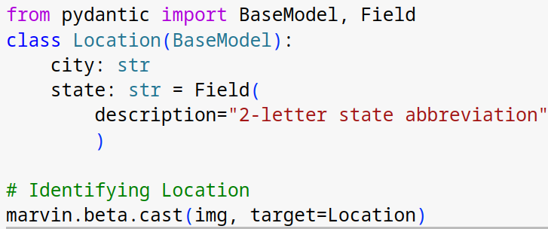
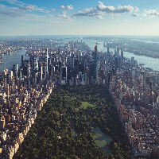
Using Marvin for Images
Images to data
Marvin can use OpenAI's vision API to process images and convert them into structured data, transforming unstructured information into native types that are appropriate for a variety of programmatic use cases.
The marvin.beta.cast function is an enhanced version of marvin.cast that accepts images as well as text.
The 'marvin.beta.cast' function can cast images to structured types.

Slide 15
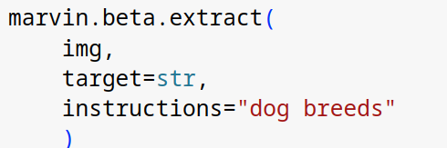
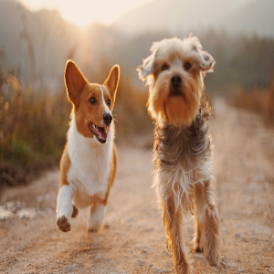
Using Marvin for Images
Information Extraction from Images
The marvin.beta.extract function is an enhanced version of marvin.extract that accepts images as well as text.
The beta extract function can extract entities from images and text.
This involves a two-step process:
First, a caption is generated for the image that is aligned with the structuring goal.
Next, the actual extract operation is performed with an LLM.

Slide 16
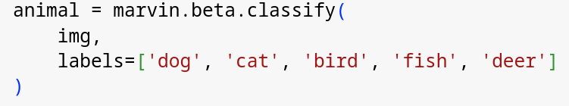
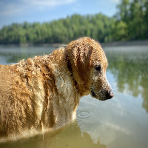
Using Marvin for Images
Classifying images
Marvin can use OpenAI's vision API to process images and classify them into categories.
The marvin.beta.classify function is an enhanced version of marvin.classify that accepts images as well as text.
The classify function can classify images as one of many labels.
This involves a two-step process:
First, a caption is generated for the image that is aligned with the structuring goal.
Next, the actual classify operation is performed with an LLM.

Slide 17
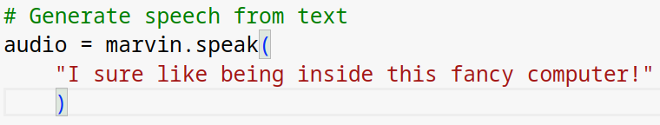

Using Marvin for Audio
Text to Speech
Marvin can generate speech from text.
The 'speak' function generates audio from text.
The @speech decorator generates speech from the output of a function.
Marvin passes your prompt to the OpenAI speech API, which returns an audio file.

Slide 18
http://tinyurl.com/marvin-ai-zsl

Slide 19
Hands-on Exercise

Slide 20
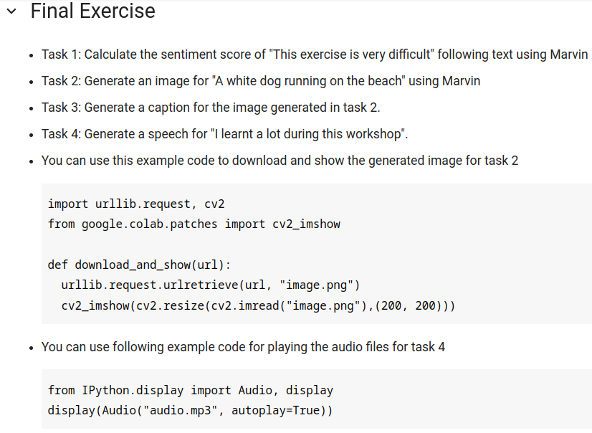
Full Screen Image
WORKSHOPS

Slide 21
http://tinyurl.com/marvin-ai-zsl

Slide 22
Quiz Time!

Slide 23
Quiz Time!
Q1. Which method can be used for both image and text classification
A. marvin.classify
B. marvin.beta.classify
C. marvin.cast
D. marvin.beta.cast

Slide 24
Quiz Time!
Q1. Which method can be used for both image and text classification
A. marvin.classify
B. marvin.beta.classify
C. marvin.cast
D. marvin.beta.cast

Slide 25
Quiz Time!
Q2. Which one is not a feature of Marvin
A. Text Generation
B. Image Recognition
C. Speech Generation
D. Speech Recognition

Slide 26
Quiz Time!
Q2. Which one is not a feature of Marvin
A. Text Generation
B. Image Recognition
C. Speech Generation
D. Speech Recognition

Slide 27
Quiz Time!
Q3. Which Model is used by Marvin for Image Generation
A. MidJourney
B. DALL-E
C. FireFly
D. DreamStudio

Slide 28
Quiz Time!
Q3. Which Model is used by Marvin for Image Generation
A. MidJourney
B. DALL-E
C. FireFly
D. DreamStudio

Slide 29
Quiz Time!
Q4. Which function is used for speech generation using Marvin
A. marvin.speech
B. marvin.speak
C. marvin.voice
D. marvin.audio

Slide 30
Quiz Time!
Q4. Which function is used for speech generation using Marvin
A. marvin.speech
B. marvin.speak
C. marvin.voice
D. marvin.audio

Slide 31
Quiz Time!
Q5. Which function is used for image generation using Marvin
A. marvin.generate
B. marvin.image
C. marvin.paint
D. marvin.caption

Slide 32
Quiz Time!
Q5. Which function is used for image generation using Marvin
A. marvin.generate
B. marvin.image
C. marvin.paint
D. marvin.caption

Slide 33
Quiz Time!
Q6. Which function is used for image captioning using Marvin
A. marvin.generate
B. marvin.image
C. marvin.paint
D. marvin.caption

Slide 34
Quiz Time!
Q6. Which function is used for image generation using Marvin
A. marvin.generate
B. marvin.image
C. marvin.paint
D. marvin.caption

Slide 35
Q & A

Slide 36
Thank You!
pquigley@zeroshotlabs.com

